Slide 1
Hibernate
Day 1

Slide 2
Objectives
Understanding of Hibernate as compared to Traditional JDBC.
Introduction to Hibernate
Understanding Hibernate Architecture
Simple Example to understand Hibernate.
Step by Step implementing Hibernate application
Hibernate Logging by Log4j using xml file

Slide 3
Understanding Hibernate Vs Traditional approach.
Wants to create a java application which will be able to store, retrieve and manipulate data from database.
Example →
Class Employee{
private int empId;
private String empName;
private String empAddress;
getters …
setters
}
Company Database
empId | empName | empAddress

Slide 4
Understanding Hibernate Vs Traditional approach.
Hibernate will create table automatically in database with respect to object
Wants to create a java application which will be able to store, retrieve and manipulate data from database.
Example →
Class Employee{
private int empId;
private String empName;
private String empAddress;
getters …
setters
}
Hibernate framework
Company Database
empId | empName | empAddress
object

Slide 5
Introduction to Hibernate
Hibernate is Java base framework which is very beneficial for developing java applications which are database driven.
Hibernate framework is lightweight and open source.
It is also called as ORM .
What is ORM? (Object Relational Mapping)
An ORM tool simplifies the data creation, data manipulation and data access. It is a programming technique that maps the object to the data stored in the database.

Slide 6
Introduction to Hibernate
Wants to create a java application which will be able to store, retrieve and manipulate data from database.
Example →
Class Employee{
private int empId;
private String empName;
private String empAddress;
getters …
setters
}
Hibernate framework
(ORM)
Company Database
empId | empName | empAddress
object

Slide 7
What is JPA?
Java Persistence API (JPA) is a Java specification that provides certain functionality and standard to ORM tools. The javax.persistence package contains the JPA classes and interfaces.

Slide 8
Advantages of Hibernate framework
Open Source and Lightweight
Fast Performance
Database Independent Query→ HQL (Hibernate Query Language) is the object-oriented version of SQL. It generates the database independent queries.
Automatic Table Creation
Simplifies Complex Join
Provides Query Statistics and Database Status

Slide 9
Hibernate Architecture
Hibernate includes some important terminologies as below:
Persistent object
Session factory
Transaction factory
Connection factory
Session
Transaction

Slide 10
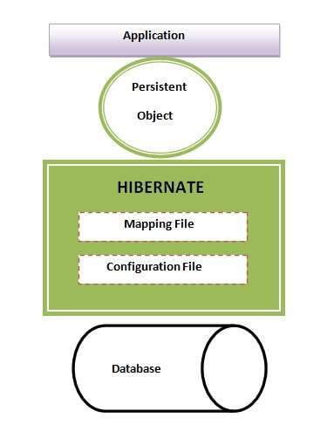
Hibernate Architecture
Hibernate Architecture is divided into four layers.
Java application layer
Hibernate framework layer
Backhand API layer
Database layer

Slide 11
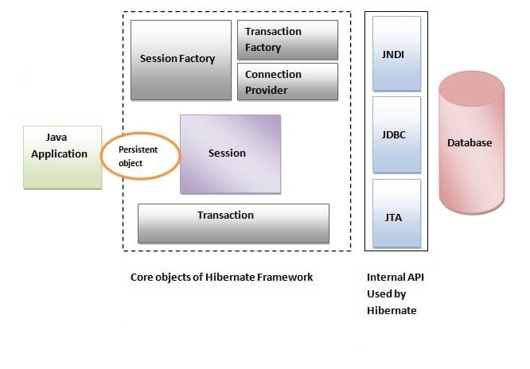
Hibernate Architecture
Core Architecture of Hibernate
Hibernate framework uses many objects such as session factory, session, transaction etc. along with existing Java API such as JDBC (Java Database Connectivity), JTA (Java Transaction API) and JNDI (Java Naming Directory Interface).

Slide 12
Components of Hibernate Architecture
SessionFactory → The SessionFactory is a factory of session and client of ConnectionProvider. It holds second level cache (optional) of data. The org.hibernate.SessionFactory interface provides factory method to get the object of Session.
Session → The session object provides an interface between the application and data stored in the database. It is a short-lived object and wraps the JDBC connection. It is factory of Transaction, Query and Criteria. It holds a first-level cache (mandatory) of data. The org.hibernate.Session interface provides methods to insert, update and delete the object. It also provides factory methods for Transaction, Query and Criteria.

Slide 13
Components of Hibernate Architecture
Transaction → The transaction object specifies the atomic unit of work. It is optional. The org.hibernate.Transaction interface provides methods for transaction management.
ConnectionProvider → It is a factory of JDBC connections. It abstracts the application from DriverManager or DataSource. It is optional.
TransactionFactory → It is a factory of Transaction. It is optional.

Slide 14
Let’s understand it with an first Example
First Application from scratch
Step 1. Create a new Java Project
Step 2. Add all required jar files.
Required jar files
MSSQL server connector
Hibernate jar files.
Step 3. Create POJO class (Persistent class).
Step 4. Create Hibernate Configuration file. (XML)
Step 5. Create Mapping file for POJO (Persistent class).

Slide 15
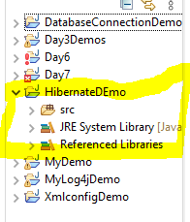
Step 1. Create new Java Project

Slide 16
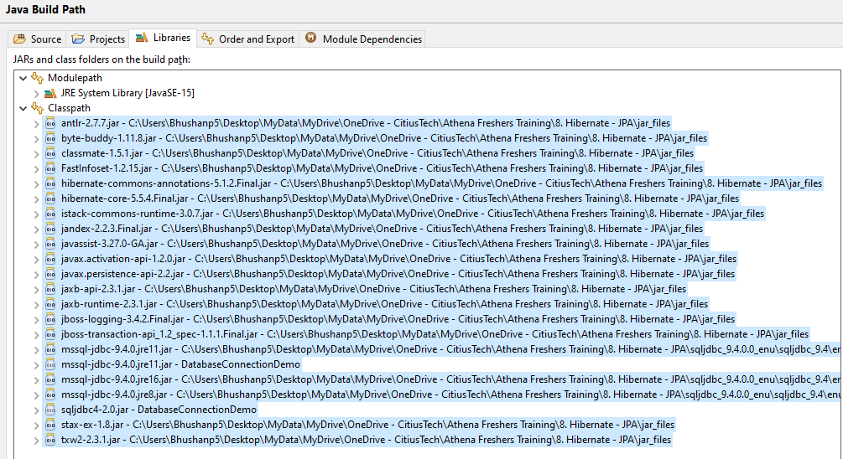
Step 2. Build Class path with required jar

Slide 17
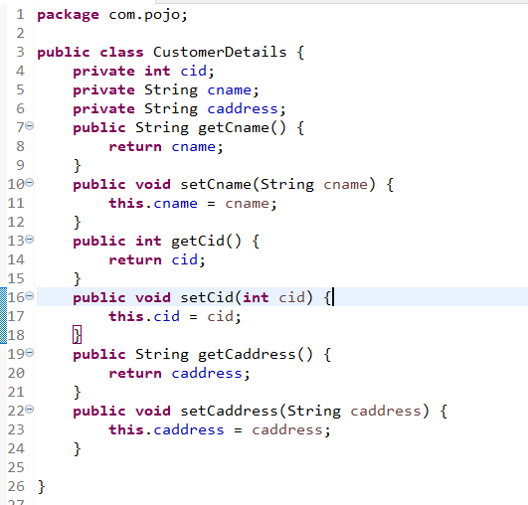
Step 3. Create POJO Class (Persistent Class)

Slide 18
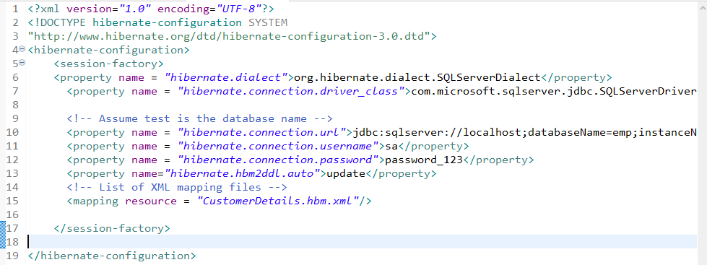
Step 4. Create Hibernate Configuration file. (XML)

Slide 19
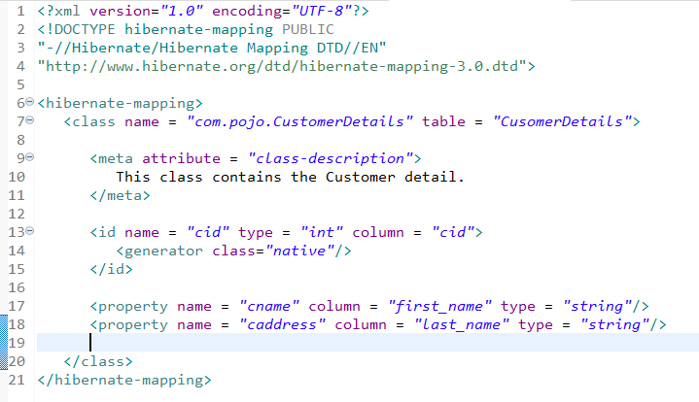
Create Mapping file for POJO (Persistent class).

Slide 20
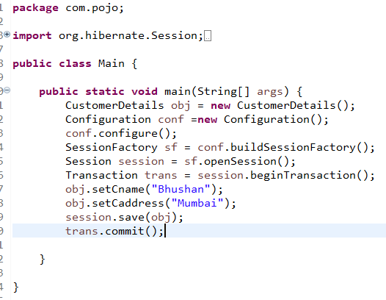
Creating main method and create object of all require classes and interfaces

Slide 21
Hibernate Application using Annotation based Configuration.
For Creating simple Hibernate application with Annotation we have to follow given below steps.
Step 1. Create a new Java Project
Step 2. Add all required jar files.
Required jar files
MSSQL server connector
Hibernate jar files.
Step 3. Create POJO class (Persistent class) and Add Annotation.
Step 4. Create Hibernate Configuration file. (XML)
In this file use <mapping class = "com.persistent.Student"/> instead of
<mapping resource = "CustomerDetails.hbm.xml"/>

Slide 22
Hibernate with Log4j
Logging enables the programmer to write the log details into a file permanently. Log4j and Logback frameworks can be used in hibernate framework to support logging.
There are two ways to perform logging using log4j:
By log4j.xml file (or)
By log4j.properties file
Level of Log4j in Hibernate
Levels Description
OFF This level is used to turn off logging.
WARNING This is a message level that indicates a problem.
SEVERE This is a message level that indicates a failure.
INFO This level is used for informational messages.
CONFIG This level is used for static configuration messages.

